Slide 1
Predicting the optimal area to open a clothing store in London, UK
IBM Applied Data Science - Capstone Project
By: Sakib Chughtai

Slide 2
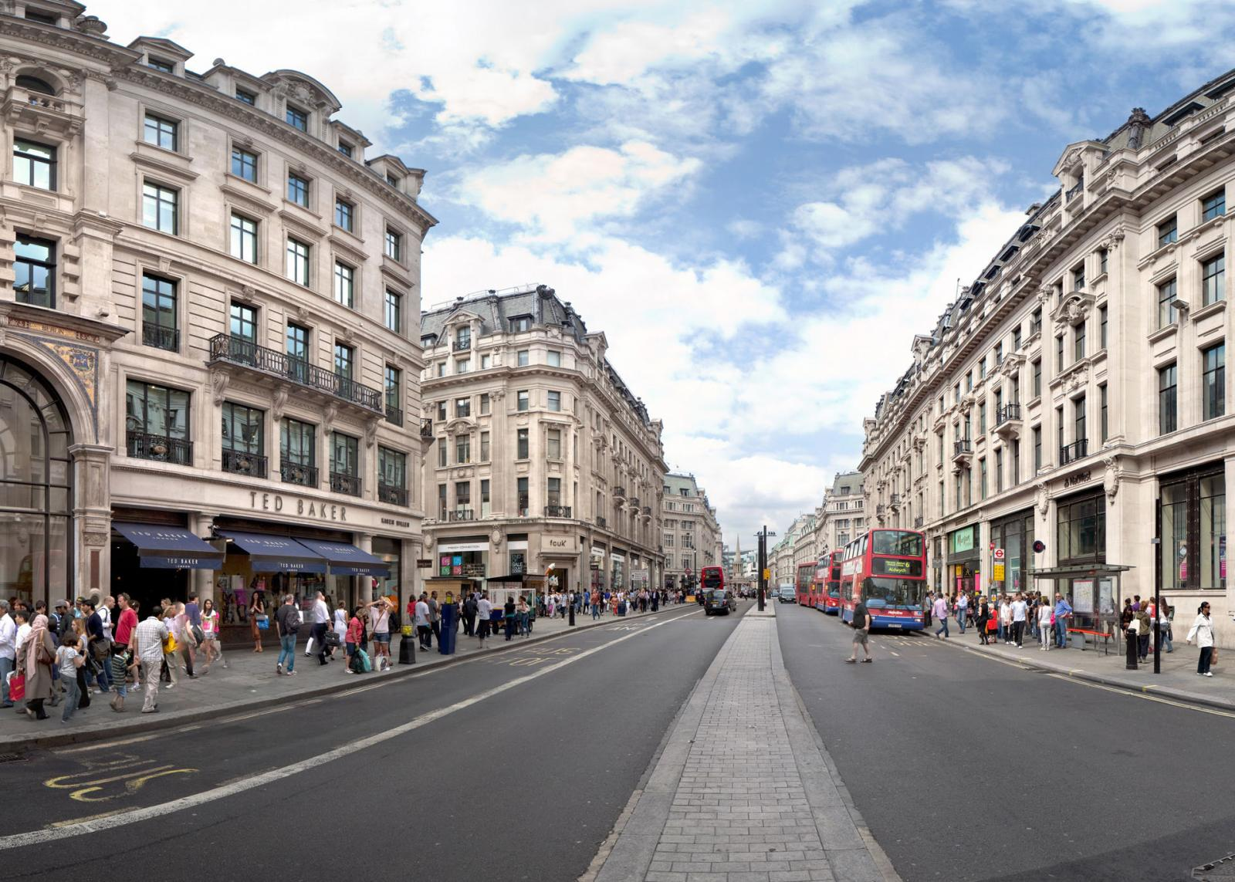
Introduction
With over 8.5 million inhabitants, London is one of the largest and most influential cities in the world.
Each year, the city attracts over 21 million international visitors as well as 28 million domestic tourists.
London is home to over 40,000 shops and 26 major street markets.
Oxford Street is known as London’s busiest shopping street and offers a wide variety of clothing stores from high end luxury brands such as Louis Vuitton to high street fashion brands such as Zara.

Slide 3
Business Understanding
The goal of this project is to predict the optimal location to open a clothing store in London, UK.
The key stakeholder in this project are investors and owners looking to start or expand their clothing company into London.
The reason why this project would be important to them is because they want to find the best area to open a store.
The optimal location to open a clothing store will be in an area where there is a high concentration of clothing stores AND shopping malls.

Slide 4
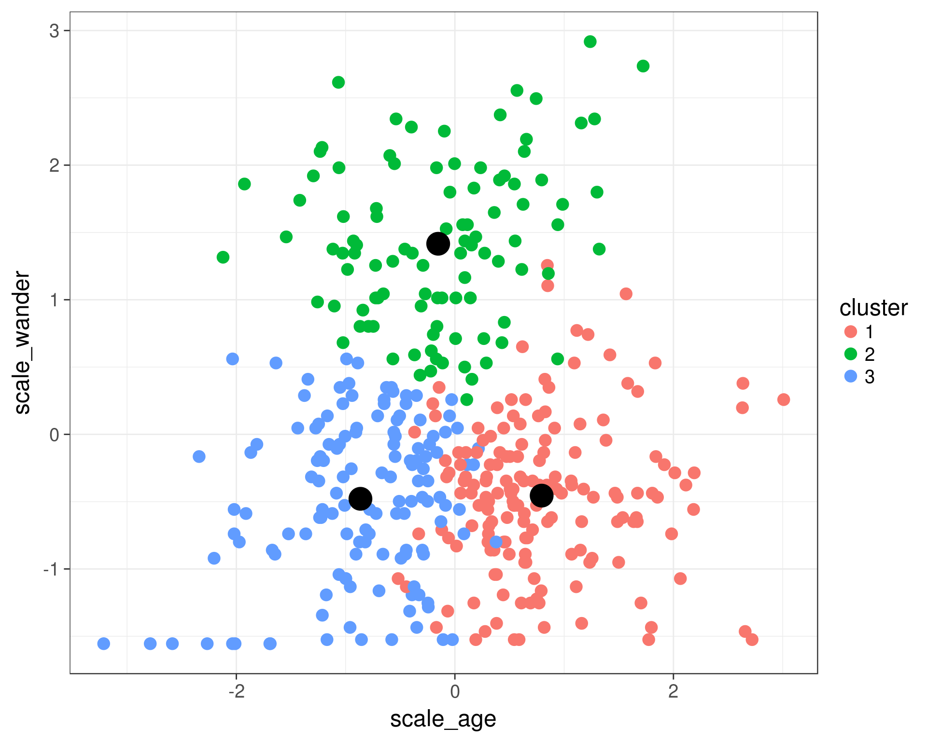
Analytics Approach
We will use K-means clustering which is a simple and popular unsupervised machine learning algorithm to answer our question.
Machine learning and visualization tools will be used to generate the most promising areas based upon criteria we defined.
Evaluation of the model quality will be done through a diagnostic measures phase and statistical significance testing.
Finally, we will present our findings to the stakeholders so they can make an informed decision on where they would like to open their clothing store.

Slide 5
Data
There are several factors that will impact the final decision of where to open a clothing store. These are
The number of clothing stores within the neighbourhood.
The number of shopping malls within the neighbourhood.
London census information – Population, density, age, income.
We will collect the data from the following sources:
London borough boundaries shapefile which is defined using longitude and latitude values. Will be in geojson format to be easily integrated into analysis. Can be obtained from the London Datastore (publicly available).
Coordinates which define the centre of London, this will be obtained using the Google Geocoding API.
Clothing stores and shopping mall data in every borough will be obtained using Foursquare API.
The centre of every borough will be defined using hexagon cells in a honeycomb layout, these will be calculated algorithmically. The addresses for those centres will be fetched using the Google Geocoding API.
London census data for the year 2016 will be obtained from the London Datastore (publicly available).

Slide 6
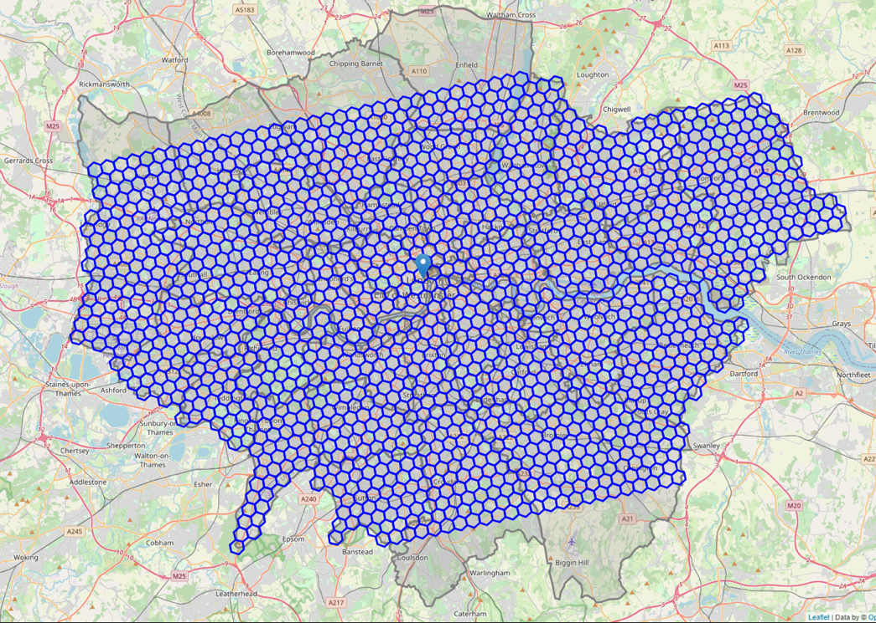
Hexagon Honeycomb Grid
We will define each neighbourhood using a grid format around the whole city. This grid will consist of many hexagons in a honeycomb layout.
This will be the basis for defining different boroughs and neighbourhoods.
The hexagon grid is limited by the boundaries of London boroughs

Slide 7
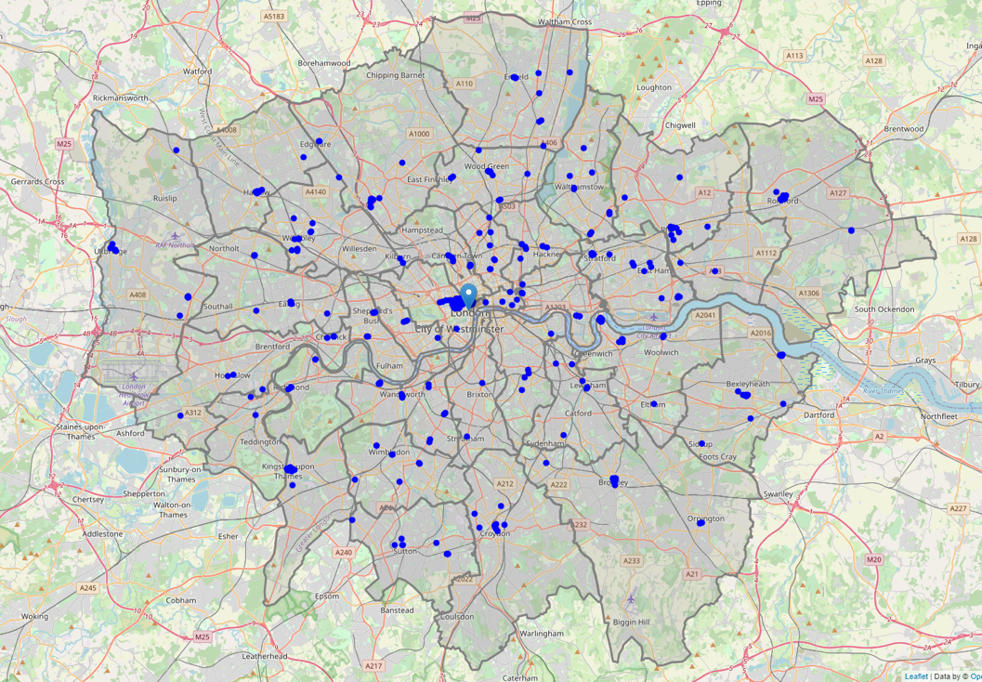
Foursquare API – All clothing stores in London
The Foursquare API is used to retrieve all clothing store information in London.
Folium Is used to visualize them on a map using blue dots.

Slide 8
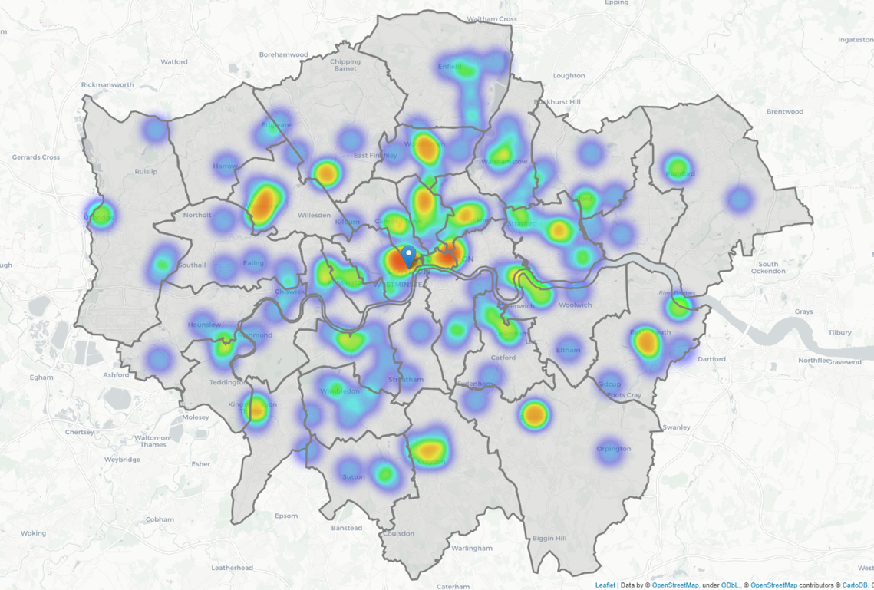
Heatmap – Clothing Stores in London
Clothing stores are mostly spread out across the city, with the highest concentration in the city centre.
The second highest concentration of clothing stores is located north of central London, in areas such as Camden and Islington.

Slide 9
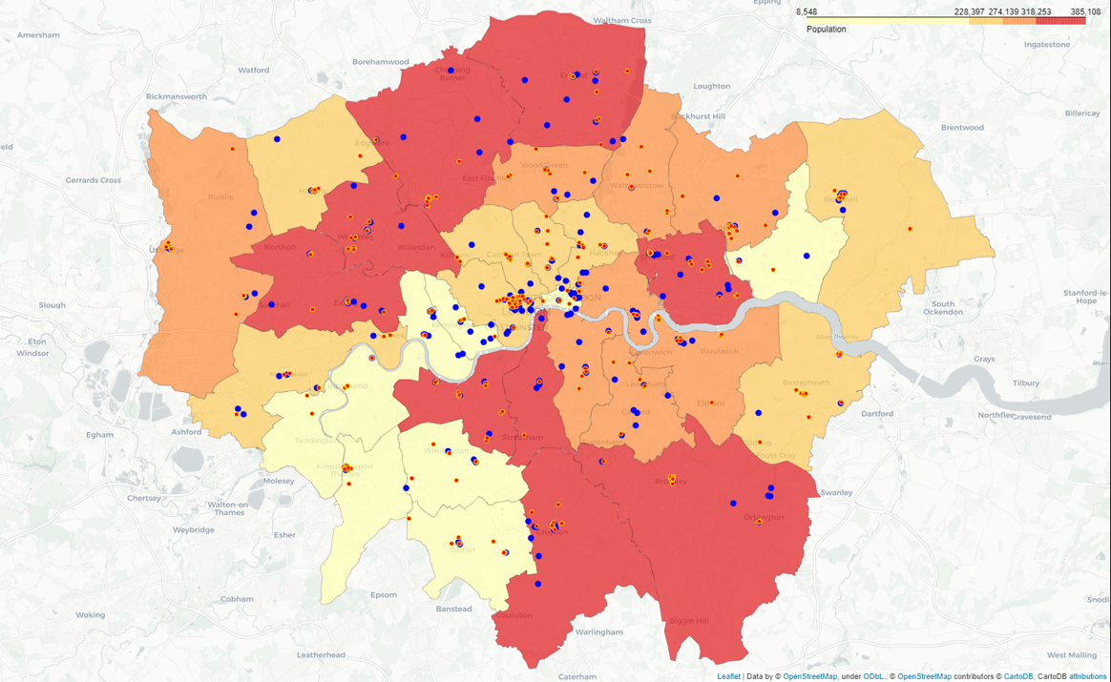
Population Distribution
Boroughs such as Ealing, Barnet, Brent, Croydon and Enfield all have a population above 318,000, and are marked in red.
Boroughs Kensington and Chelsea, Hammersmith and Fulham, Kingston and Richmond all have populations below 228,000.
There isn’t to be a correlation between population and number of clothing stores or shopping malls

Slide 10
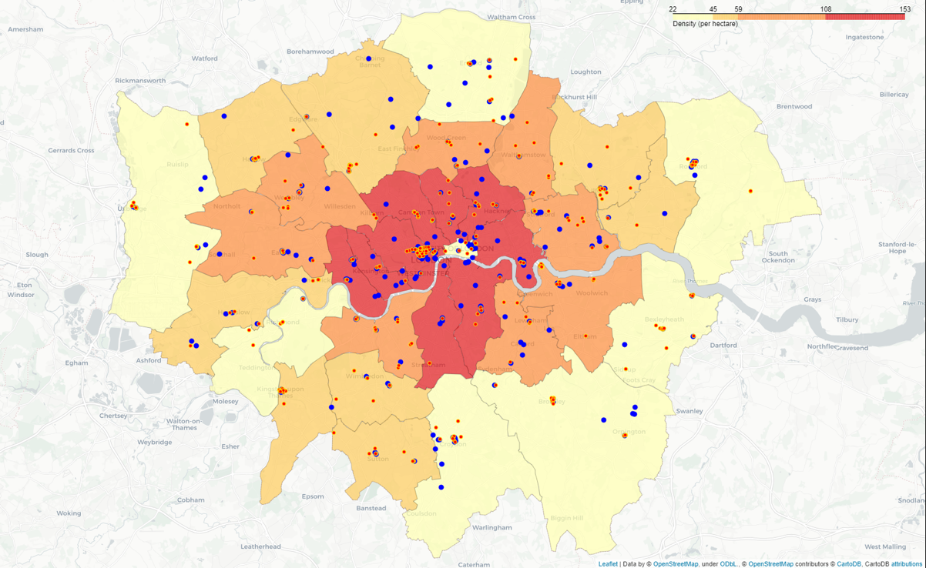
Density Distribution
Boroughs surrounding the center of London have the highest population density.
There is a higher population density in areas where there are a high concentration of clothing stores and malls.

Slide 11
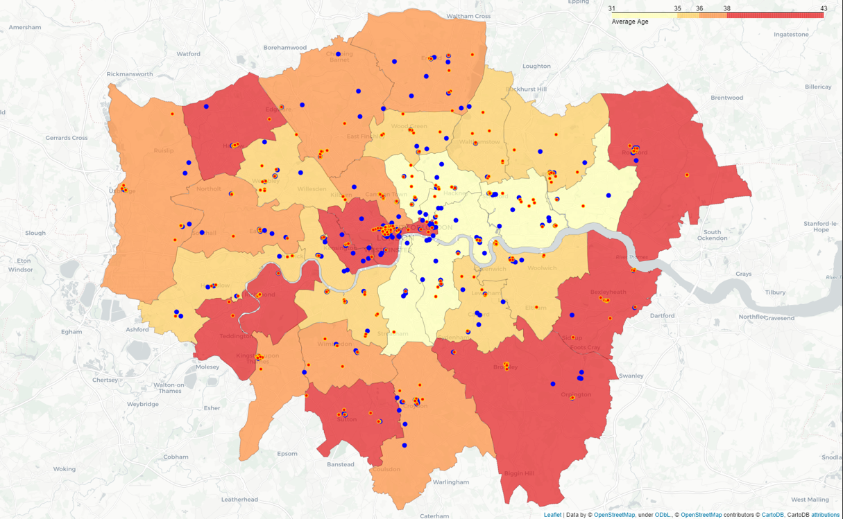
Age Distribution
Boroughs in the east tend to have a lower average age (below 35).
Meanwhile boroughs in the eastern suburbs have a higher average age (above 38).
There is not a correlation between average age and the number of clothing stores/shopping malls in the borough.

Slide 12
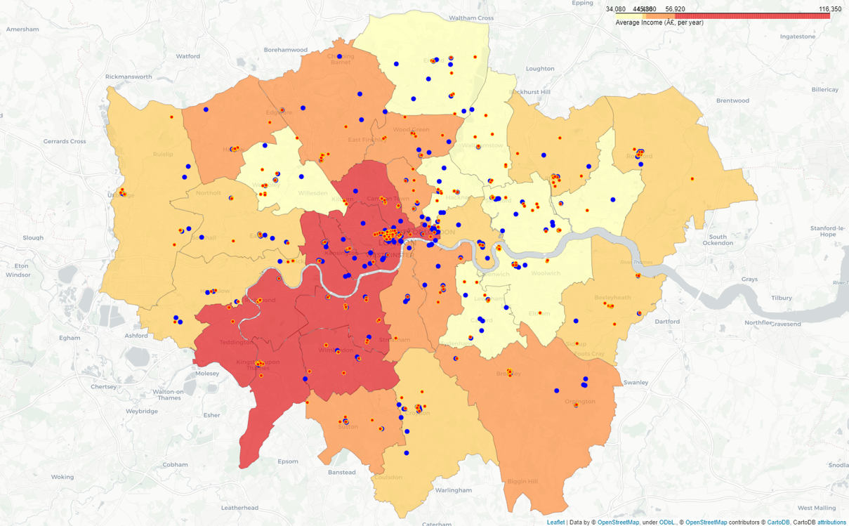
Income Distribution
Boroughs in central London and south-west London have the highest income on average.
Westminster, Camden, Kensington and Hammersmith all have an average income above £56,000.
Boroughs in the east such as Lewisham, Hackney, Greenwich and Newham are amongst the lowest in terms of average income, with people earning less than £44,000.

Slide 13
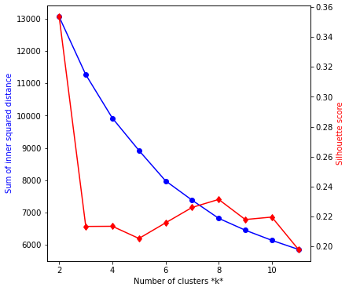
K-Means Clustering
K=8 was chosen to reflect a balanced number between the Sum of squared difference and silhouette score.
Sum of Squared Distance (SSD) starts at a high value (13000) at K=2 and gradually decreases as K approaches 10.
For silhouette score, at K=2 the score starts off high (0.36) but drastically decreases to (0.21) at K=3.

Slide 14
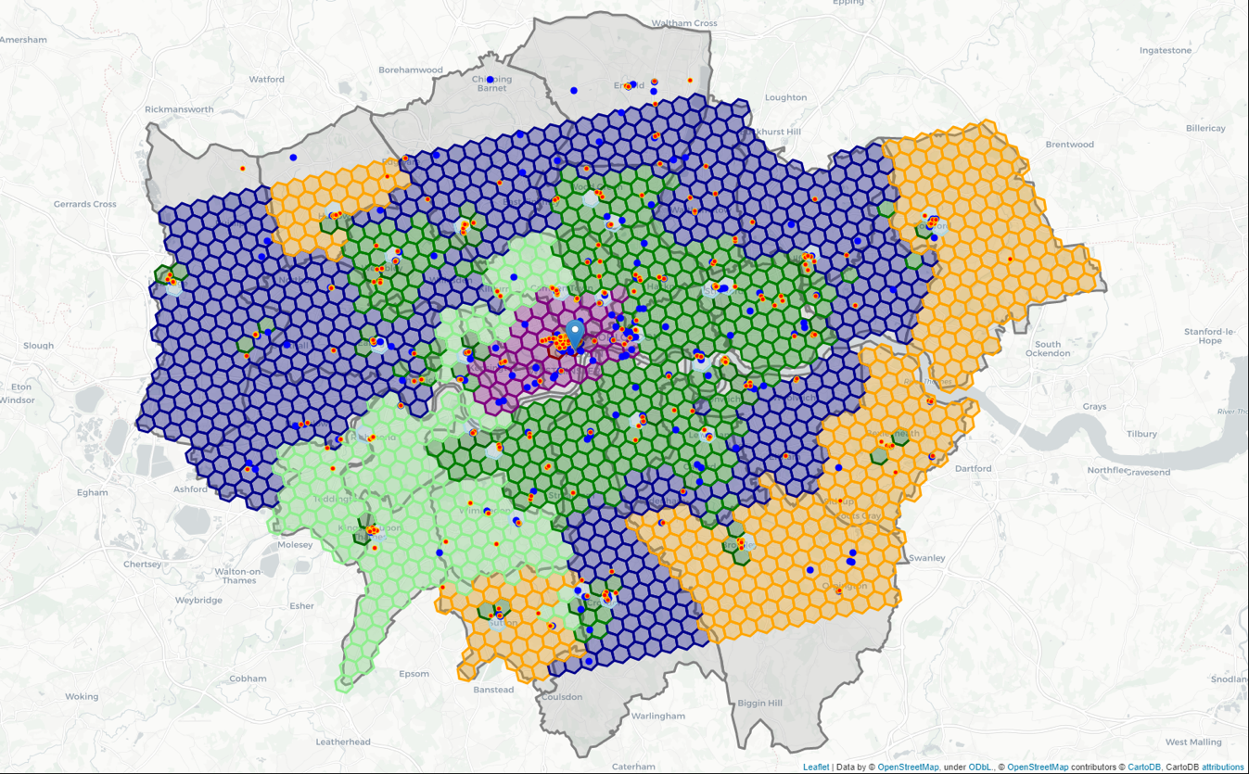
Cluster Plot
The clusters in red and purple represent the best possible areas to open a store.
The red cluster containing 3 hexagon cells is the best possible area to open a store as there are an abundance of clothing stores and shopping malls and the population density and average income is very high.
Boroughs located in the suburbs tend to be similar to their neighbours (yellow/blue)

Slide 15
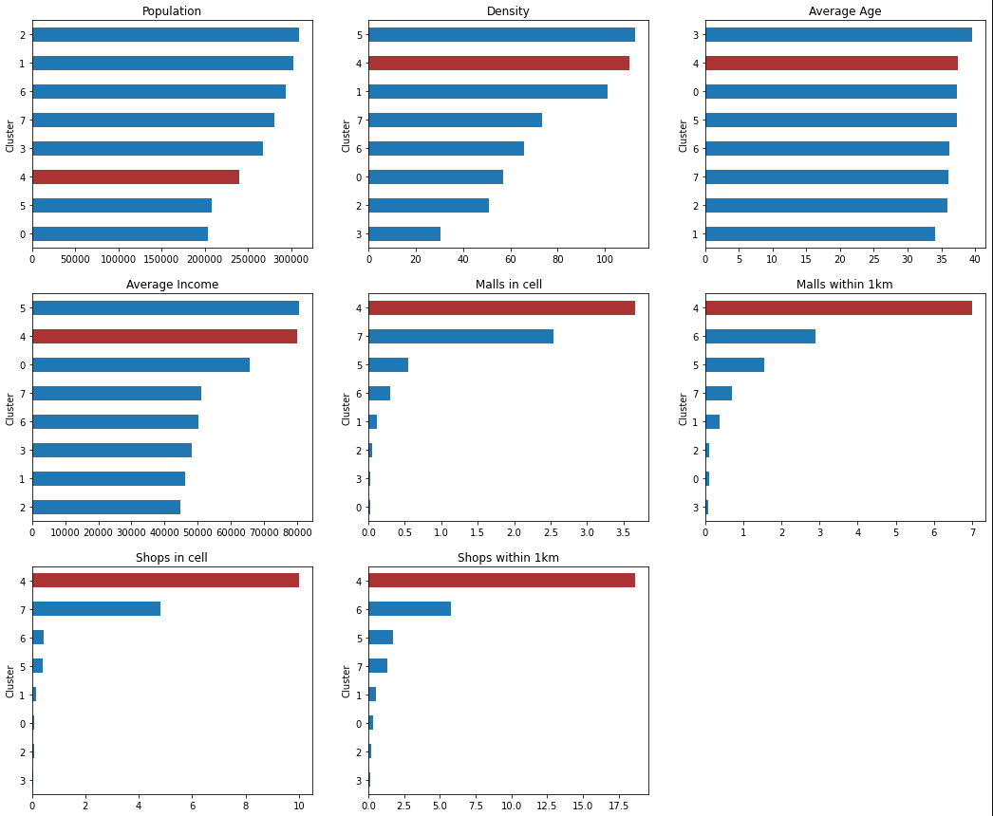
Comparison of clusters
Cluster 4 has one of the lowest population counts, however it has one of the highest density counts.
We can also see that Cluster 4 has the second highest average income, which is very promising for stakeholders who want to open a clothing store in that area.
Lastly, we can see that there is a large number of shops and malls within cluster 4, compared to other cells.

Slide 16
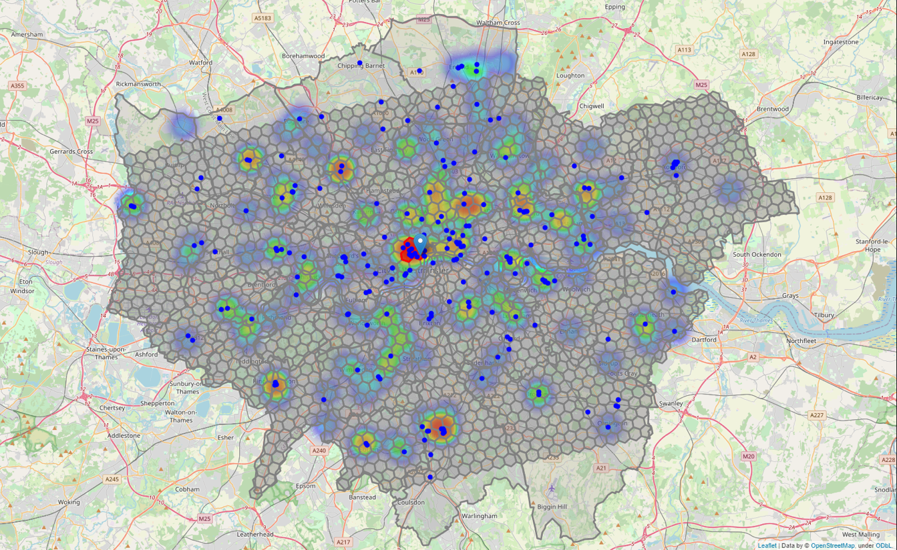
Target Cluster Plot
The target cluster contains the highest concentration of clothing stores and shopping mall, which satisfy the criteria we defined at the start of the project.
This cluster also boasts the highest average income and density.

Slide 17
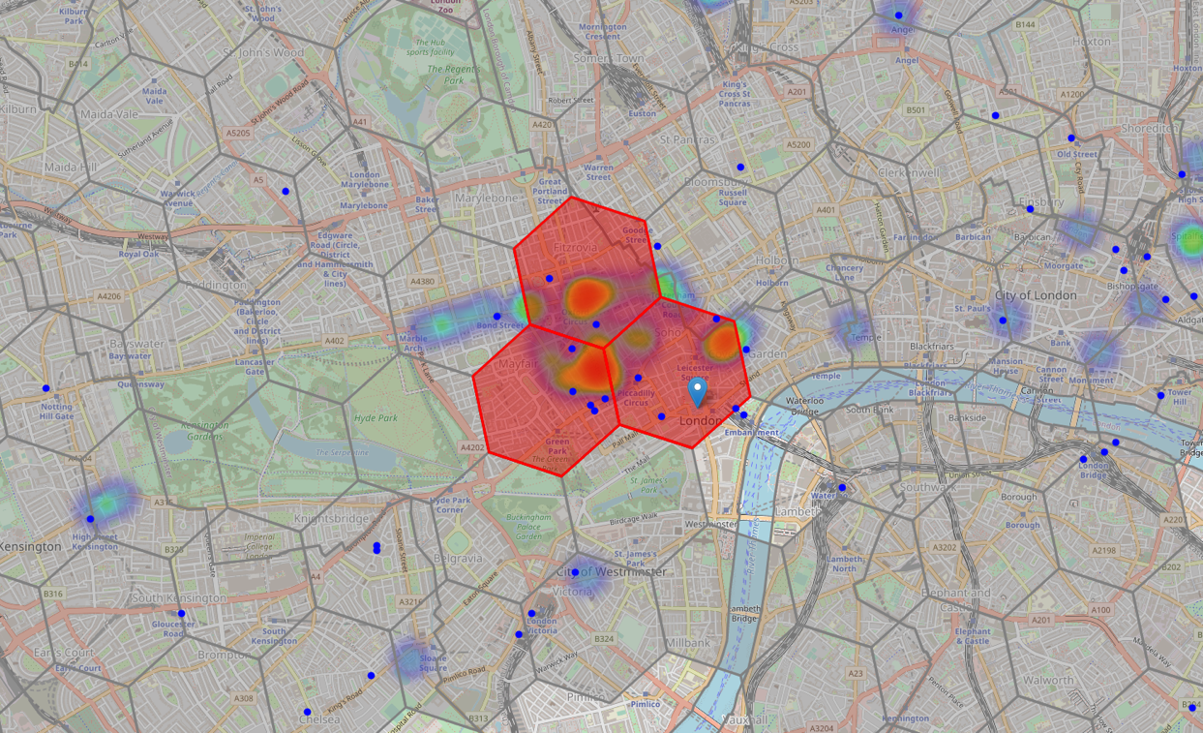
A closer look at the target cluster

Slide 18
Results
After segmenting and clustering every single neighbourhood within London, we were able to accurately determine which areas are the most promising to open a clothing store.
We found a hexagon cluster consisting of 3 cells which was the most promising cluster of all 8.
Located right by the center of London (Trafalgar Square), this cluster contains the highest concentration of clothing stores and shopping mall. Additionally, the census data in this cluster is very promising.
A very high population density indicates that there are a lot of people present in the area, and most likely visiting different shops.
A high average income is also beneficial because consumers are more likely to have a higher disposable income, which can be spent on clothing.
This leads to more sales and ultimately higher profits, a vital factor for owners looking for ideal places to open a business.

Slide 19
Conclusion
The goal of this project was to find the best area to open a clothing store in London.
All in all, we were able to achieve the goal we set out at the beginning. Although we collected enough and analysed data to answer the question, adding more features to the model would allow stakeholders to gain a more sophisticated understanding of London.
If we added a feature dedicated to commercial real estate/rent prices, we could advise stakeholders different areas based upon their budget.
Now equipped with insights and factual data, stakeholders can now ultimately decide and explore which area they think has the most potential.
Their decision, however, could be impacted by other factors that we have not covered in this analysis.
For example, revenue for existing clothing stores, rent prices and traffic could all impact the stakeholder's final decision.

Slide 20
References
Open a Movie Theatre in Montreal (accessed at: https://towardsdatascience.com/the-battle-of-the-neighborhoods-open-a-movie-theater-in-montreal-355cf5c679b8)
Census Data for London (accessed at: https://data.london.gov.uk/census/)
London boundaries data (accessed at: https://data.london.gov.uk/dataset/statistical-gis-boundary-files-london)
Foursquare Places API Documentation (accessed at: https://developer.foursquare.com/docs/places-api/)
Folium documentation (accessed at: https://python-visualization.github.io/folium/)
NumPy documentation (accessed at : https://numpy.org/doc/)
Pandas documentation (accessed at: https://pandas.pydata.org/docs/)
K- means clustering documentation (accessed at: https://scikit-learn.org/stable/modules/generated/sklearn.cluster.KMeans.html)
Google geocoding API documentation (accessed at: https://developers.google.com/maps/documentation/geocoding/overview)

